Slide 1
AKS PRIMALITY TEST
Osho Agyeya(15BCE1326) Shivam Prasad(15BCE1196)
Malladi Tejasvi(15BCE1208)
Shubankar B(15BCE1123) Shivam Pratap Singh(15BCE1053)

Slide 2
Focal points
Significant Aspects
Performance evaluation
Idea;Algorithm;Analysis

Slide 3
SIGNIFICANT POINTS:
Invented by Manindra Agrawal,Neeraj Kayal & Nitin Saxena
Unconditional:No constraints involved
Deterministic:Solves the problem with exact decision at every step;no guesses involved;machine’s current state determines what its next state will be; computes a mathematical function which has a unique value for any input in its domain
Polynomial time complexity:Running time is upper bounded by a polynomial expression in the size of the input(no. of digits) for the algorithm

Slide 4
SIEVE OF ERATOSTHENES
2
3
4
5
6
7
8
9
10
11
12
13
14
15
16
17
18
19
20
21
22
23
24
25
26
27
28
In mathematics, the sieve of Eratosthenes, one of a number of prime number sieves, is a simple, ancient algorithm for finding all prime numbers up to any given limit.
It does so by iteratively marking as composite (i.e., not prime) the multiples of each prime, starting with the multiples of 2.

Slide 5
ALGORITHM:
for all numbers m: 2 .. n, if m is unmarked:
add m to primes list;
mark all it's multiples, lesser or equal, than n (k * m ≤ n, k ≥ 2);
otherwise, if m is marked, then it is a composite number.

Slide 6
THE IDEA:
Let a be an integer & n be a natural number such that n>=2,HCF of a & n is 1.Then n is prime iff:
(x+a)^{n} =x^{n} +a (mod n) ,i.e. all the coefficients in ((x+a)^{n} –(x^{n} +a) ) should be perfectly divisible by n.
In other words,^{n}C_{i}*a^{(n-i)} is perfectly divisible by n for 0<i<n.

Slide 7
IMPROVEMENT:
However, this takes Ω(n) because we need to evaluate n coefficients in the LHS in the worst case.To simplify the above condition,we check iff
(x+a)^{n} = (x^{n}+a) (mod x^{r}-1,n),i.e (x+a)^{n} -(x^{n}+a)=nf+g(x^{r}-1) for some polynomials g,f and appropriately chosen small r which is a natural no.

Slide 8
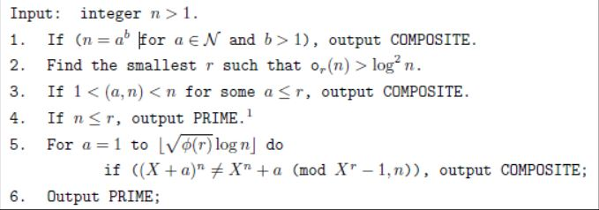
THE ALGORITHM:
In step 2,o_{r}(n) means finding the smallest number k such that n^{k} -1 is divisible by r(r is a natural no).
In step 3,(a,n) represents HCF of a and n.
In step 5, Φ(r) gives the number of numbers less than r that are relatively prime to r. Floor function has been used in the test expression.

Slide 9
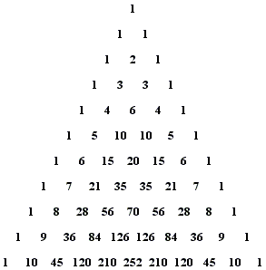
INTERPRETATION OF AKS TEST
ALGORITHM-
Generate the row of the Pascal’s triangle corresponding to the no. which needs to be checked for primality.
Leaving the first and the last 1’s, check whether the remaining terms are divisible by the no. or not.
If all the terms are divisible by the number, the number is prime. Else it is composite.

Slide 10
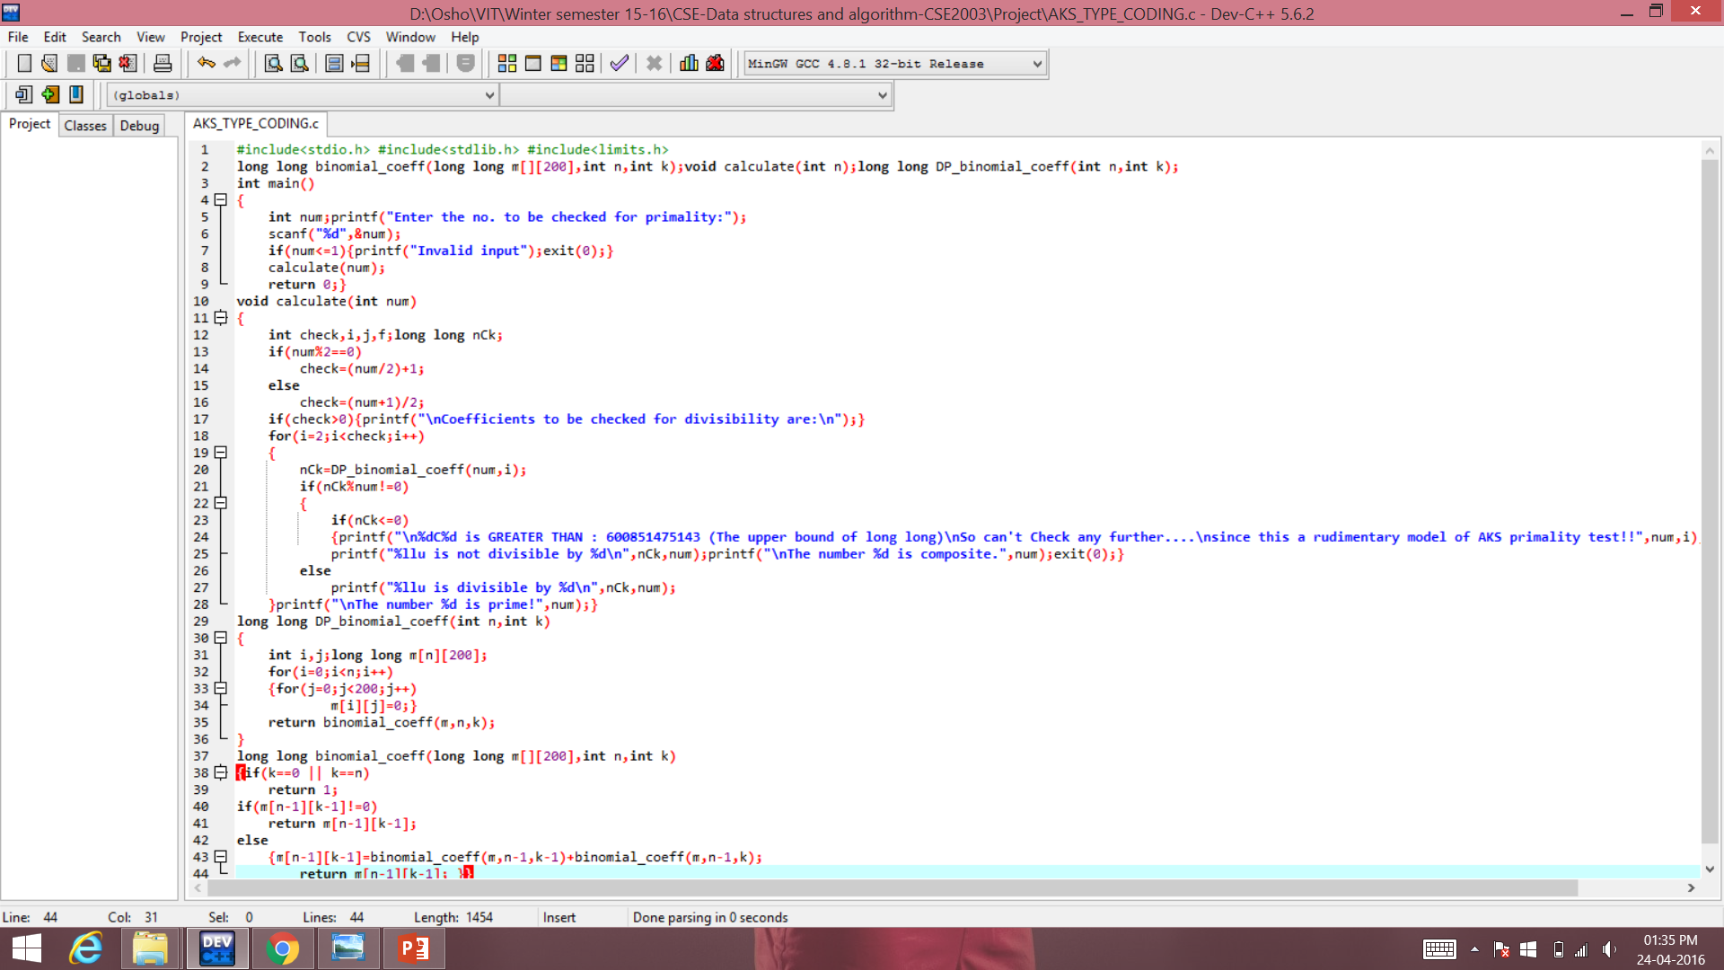

Slide 11
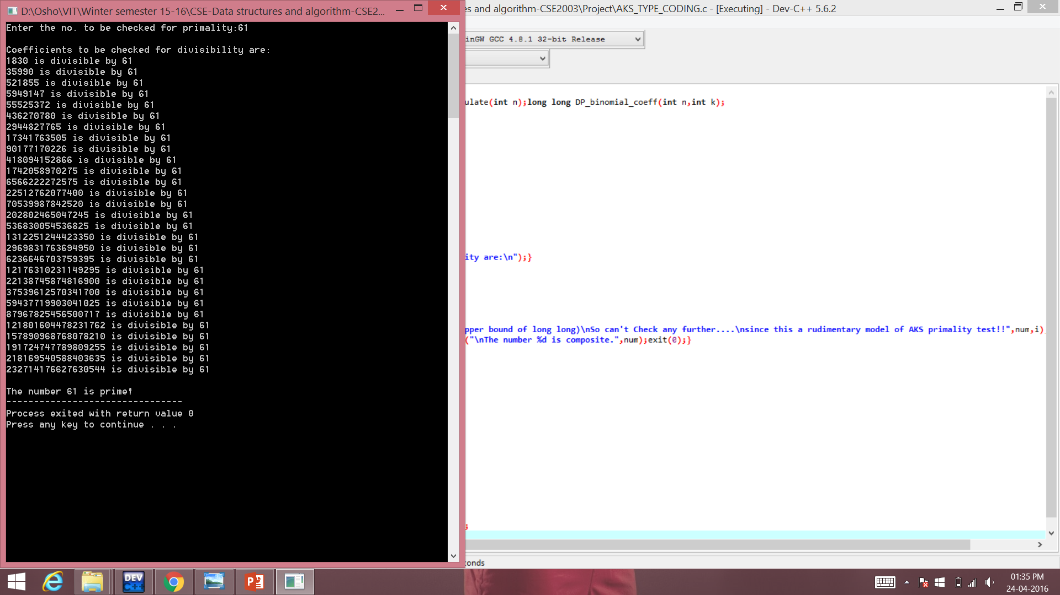

Slide 12
Time Complexity
An algorithm is said to be solvable in polynomial time if the number of steps required to complete the algorithm for a given input is O(n^k) for some nonnegative integer k, where n is the complexity of the input.
Polynomial-time algorithms are said to be "fast."
In the first version of the above-cited paper, the authors proved the asymptotic time complexity of the algorithm to be O(log(n)^12) .In other words, the algorithm takes less time than the twelfth power of the number of digits in n for primality check.
In 2005, Carl Pomerance and H. W. Lenstra, Jr. demonstrated a variant of AKS that runs in
O(log(n)^6) operations, where n is the number to be tested - a marked improvement over
the initial bound.

